Slide 1
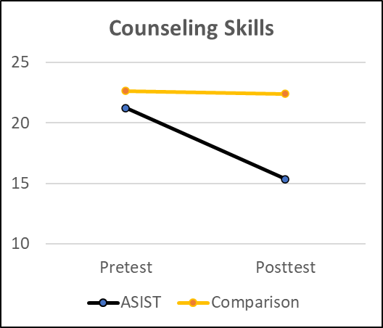
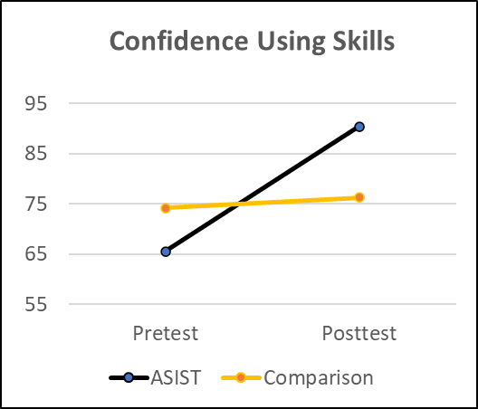
Teaching suicide intervention skills to social work students: An evaluation
Carol Coohey and Miriam J. Landsman
University of Iowa School of Social Work
Why Teach Suicide-Specific Intervention Skills?
Suicide-Specific Counseling Model
Methods
Results
We offered the Applied Suicide Intervention Skills Training (ASIST) as a for-credit course. It included the ASIST two-day, 16-hour skills training. ASIST is both a crisis intervention and counseling model.
ASIST teaches six essential skills:
explore invitations (or hints) that they are thinking about suicide
directly ask whether they are thinking about suicide
actively listen to/hear their suicide story and assess resources, such as social support
support them by reflecting on their ambivalence and turning them toward safety planning
develop a safe plan, including disabling active suicide plan
confirm actions in the safe plan
ASIST provides several opportunities for students/trainees to practice skills.
Design and Sample
Quasi-experiment. Compared SW students in a suicide skill-building course (intervention) with SW students completing a skills course without suicide content.
Courses same length, format, time, and location; no difference in demographic characteristics of students at pre-course, suggesting equivalence
N= 64 (required power: N=36)
Primarily identify as White (67%), women (83%)
Measures
Suicide-Specific Skills
Suicide Counseling Skills Inventory with 10 hypothetical client-helper scenarios; rated three helper responses per scenario
20 items measured all six ASIST skills
calculated discrepancy scores (subtract their score from the experts’ mean score)
Smaller scores are better because they show that the trainee’s skills are more like the experts’ skills.
Confidence Using These Skills
Suicide Counseling Confidence Scale
6 items measured confidence in using all six ASIST skills
Higher scores are better = more confident
Data Analysis
Repeated measure GLM tested the interaction between time (pre- to post-course change on skills and confidence) and course (ASIST v. comparison course).
SPSS GLM calculated effect sizes using the partial eta‐squared statistic (η_{p}²). A large effect is.14 or higher (small: .01; medium: .06).
The main and interaction effects were very large for both outcomes.
Skills: main effect: η_{p}²=.29, interaction: η_{p}²=.26
Confidence: main effect: η_{p}²=.47, interaction: η_{p}²=.36
Most social workers encounter people contemplating suicide.
A client’s suicide can have a devastating effect on a social worker’s mental health.
Nevertheless, most social work students receive no suicide intervention skill development during their degree program—unlike counseling programs.
Social workers, regardless of whether they are in a counseling role, should be confident they can use basic suicide-specific intervention skills.
Implications
ASIST can be offered as a 1 credit hour course or CEU opportunity for field instructors and others
ASIST training could be integrated into an existing course
Find a Certified ASIST Trainer
References
Coohey, C. et al. (2022). Validation of the Suicide Counseling Skills Inventory (SCSI). Crisis, 43(3), 170–182.
Kourgiantakis, T., et al. (2019). Social work education and training in mental health, addictions, and suicide: A scoping review protocol. BMJ Open, 9(6), e024659.
Richardson, J. T. (2011). Eta squared and partial eta squared as measures of effect size in educational research. Educational Research Review, 6(2), 135-147.
Minton, C. A., & Pease-Carter, C. (2011). The status of crisis preparation in counselor education. Journal of Professional Counseling, 38(2), 5-17.
Cntrl+Click and
search by city
Acknowledgment
This presentation was supported by the Scanlan Center for School Mental Health, UI, and the IA Department of Education

